Slide 1
Introduction to Web Technology and Development
Week-1

Slide 2
Chapter 1
1
2
A Complicated Ecosystem
Definitions and History
3
The Client-Server Model
4
Where is the Internet?
5
Working in Web Development
6
Summary

Slide 3
Chapter 1
1
2
A Complicated Ecosystem
Definitions and History
3
The Client-Server Model
4
Where is the Internet?
5
Working in Web Development
6
Summary

Slide 4
A Complicated Ecosystem

Slide 5
Chapter 1
1
2
A Complicated Ecosystem
Definitions and History
3
The Client-Server Model
4
Where is the Internet?
5
Working in Web Development
6
Summary

Slide 6
Definitions and History
A Short History of the Internet
Telephone Network
Packet Networks
ARPANET (1969)
X.25 (1974)
USENET (1979)
TCP/IP (1983) ← INTERNET

Slide 7
Definitions and History
The Internet and WWW are different (but related) things

Slide 8
Definitions and History
The Birth of the Web (1990)
URLS
HTTP
SERVERS
BROWSERS
HTML

Slide 9
Definitions and History
The Growth of the Internet

Slide 10
Definitions and History
Web Applications in Comparison to Desktop Applications
Advantages:
Accessible from any Internet-enabled computer.
Usable with different operating systems and browser applications.
Easier to roll out program updates
Fewer security concerns about local
Storage.

Slide 11
Definitions and History
Web Applications in Comparison to Desktop Applications
Disadvantages:
Requirement to have an active Internet connection
Security concerns about sensitive private data being transmitted over the
Internet.
Concerns over the storage, licensing, and use of uploaded data.
Problems with certain websites not having an identical appearance across all
browsers.
Restrictions on access to operating system resources
Clients or their IT staff may have additional plugins added
to their browsers

Slide 12
Definitions and History
Static Websites versus Dynamic Websites

Slide 13
Definitions and History
Static Websites versus Dynamic Websites

Slide 14
Definitions and History
Static Websites versus Dynamic Websites

Slide 15
Definitions and History
Web 2.0 and Beyond
Web 2.0 Dynamic
Web 3.0 Semantic
Web Science
…

Slide 16
Definitions and History
Sociotechnological Integration—Web Science

Slide 17
Chapter 1
1
2
A Complicated Ecosystem
Definitions and History
3
The Client-Server Model
4
Where is the Internet?
5
Working in Web Development
6
Summary

Slide 18
The Client-Server Model
The Request-Response Loop

Slide 19
The Client-Server Model
The Peer-to-Peer Alternative

Slide 20
The Client-Server Model
Server Types
Web Servers
Application Servers
Database Servers
Mail Servers
Media Servers
Authentication Servers
…

Slide 21
The Client-Server Model
Real-World Server Installations – Server Farm

Slide 22
The Client-Server Model
Real-World Server Installations – Server Rack

Slide 23
The Client-Server Model
Real-World Server Installations – Data Center

Slide 24
Chapter 1
1
2
A Complicated Ecosystem
Definitions and History
3
The Client-Server Model
4
Where is the Internet?
5
Working in Web Development
6
Summary

Slide 25
Where Is the Internet?
From the Computer to the Local Provider

Slide 26
Where Is the Internet?
(Simplified) Routing Tables

Slide 27
Where Is the Internet?
From the Local Provider to the Ocean’s Edge

Slide 28
Where Is the Internet?
From the Local Provider to the Ocean’s Edge –IXP and Data Centers

Slide 29
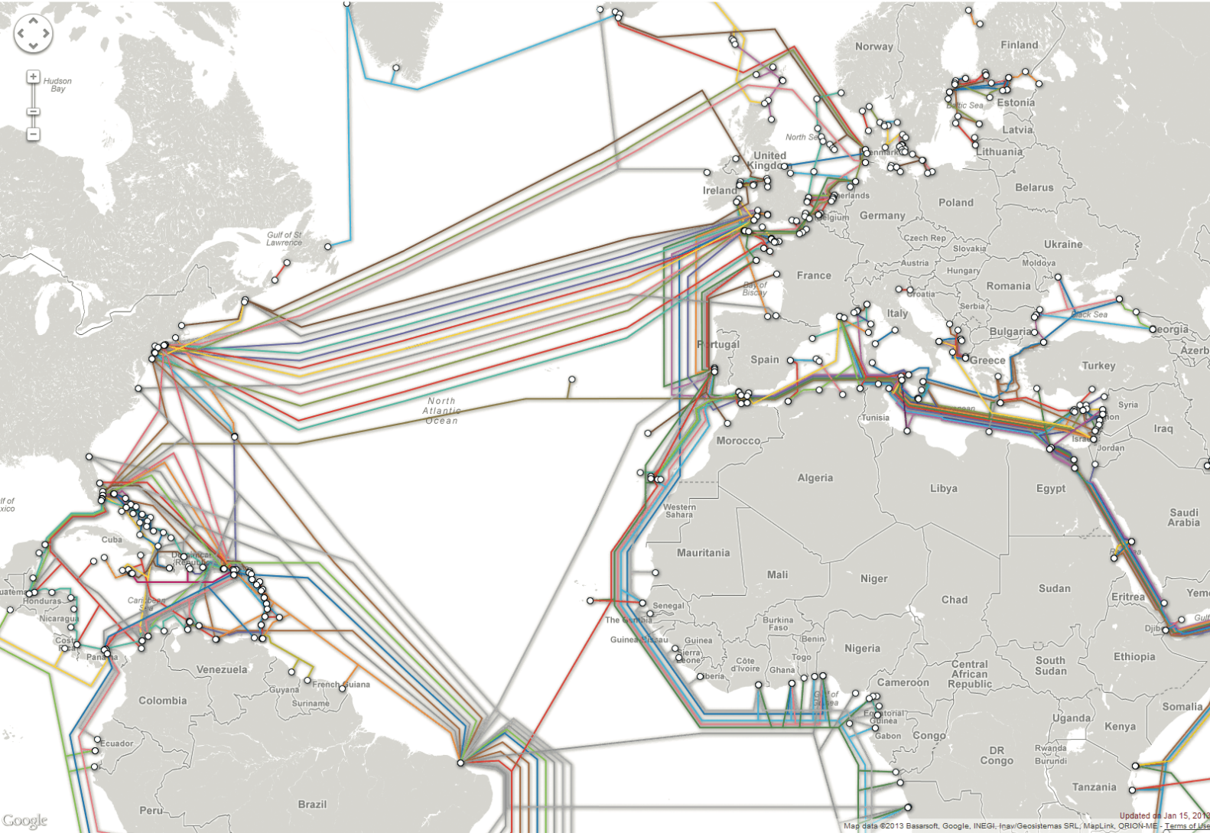
Where Is the Internet?
Across the Oceans

Slide 30
Chapter 1
1
2
A Complicated Ecosystem
Definitions and History
3
The Client-Server Model
4
Where is the Internet?
5
Working in Web Development
6
Summary

Slide 31
Working in Web Development
Roles and Skills

Slide 32
Working in Web Development
Roles and Skills
Hardware Architect/Network Architect/Systems Engineer
System Administrator
Database Administrator/Data Architect
Security Specialist/Consultant/Expert
Developer/Programmer
Front-End Developer/UX Developer

Slide 33
Working in Web Development
Roles and Skills (II)
Software Engineer
UX Designer/UI Designer/Information Architect
Tester/Quality Assurance
SEO Specialist
Content Strategists/Marketing Technologist
Project Manager/Product Manager
Business Analyst
Nontechnical Roles

Slide 34
Working in Web Development
Types of Web Development Companies

Slide 35
Chapter 1
1
2
A Complicated Ecosystem
Definitions and History
3
The Client-Server Model
4
Where is the Internet?
5
Working in Web Development
6
Summary

Slide 36
Summary
Key Terms
application server
authentication server
bandwidth
broadband modem
cable modem termination
system
circuit switching
client
client-server model
data center
database server
DevOps
dynamic website
failover redundancy
fiber optic cable
full-stack developer
HTTP
intranet
Internet exchange point
(IX or IXP)
Internet service provider
(ISP)
load balancers
mail server
media server
Mosaic
Netscape Navigator
Network Access Points
(NAP)
next-hop routing
packet
packet switching
peer
peer-to-peer
model
request
Request for Comments
(RFC)
request-response loop
response
router
routing table
semantic web
server
server farm
server racks
shared hosting
static website
user experience
virtual server
webmaster
Web 2.0
World Wide Web
Consortium (W3C)

Slide 37
Questions?

